Slide 1
Basic Processing Unit

Slide 2
Overview
Processor is also called Instruction Set Processor (ISP)
Central Processing Unit (CPU)
A typical computing task consists of a series of steps specified by a sequence of machine instructions that constitute a program.
An instruction is executed by carrying out a sequence of more rudimentary operations.

Slide 3
Some Fundamental Concepts
Execution of a Complete Instruction
Hardwired Control
Microprogrammed Control

Slide 4
Processor fetches one instruction at a time and perform the operation specified.
Instructions are fetched from successive memory locations until a branch or a jump instruction is encountered.
Processor keeps track of the address of the memory location containing the next instruction to be fetched using Program Counter (PC).
Instruction Register (IR)

Slide 5
Three steps performed by the processor to execute an instruction
1) Fetch the contents of the memory location pointed to by the PC. The contents of this location are loaded into the IR (fetch phase).
IR ← [[PC]]
2) Assuming that the memory is byte addressable, increment the contents of the PC by 4 (fetch phase).
PC ← [PC] + 4
3) Carry out the actions specified by the instruction in the IR (execution phase).

Slide 6
Registers,
ALU and interconnecting bus -Datapath

Slide 7
Executing an instruction has one or more of the following operations in sequence
Transfer a word of data from one processor register to another or to the ALU.
Perform an arithmetic or a logic operation and store the result in a processor register.
Fetch the contents of a given memory location and load them into a processor register.
Store a word of data from a processor register into a given memory location.

Slide 8
Register Transfers
Internal processor
b
us
R
i
in
Two control Signals
1)Place the content of register to bus,
Ri_{out} is set to 1
2)Load the data on bus to register ,
Ri_{in} is set to 1
Example
Transfer content of R1 to R4
R1_{out} is set to 1
R4_{in} is set to 1
R
i
R
i
out
Y
in
Y
Constant 4
Select
MUX
A
B
ALU
Z
in
Z
Z
out
Figure 7.2. Input and output gating for the registers in Figure 7.1.

Slide 9
All operations and data transfer takes place within time period defined by processor clock
The control signals are asserted at the start of the clock cycle
Registers consists of edge-triggered flip-flops
In another scheme, data transfer may use both rising and falling edges of the clock
When edge-triggered flip-flops are not used, two or more clock signals may be needed for proper transfer of data, which is known as multiphase clocking

Slide 10
Performing an Arithmetic or Logic Operation
The ALU is a combinational circuit that has no internal storage.
ALU gets the two operands from MUX and bus. The result is temporarily stored in register Z.
Example - Add the contents of register R1 to those of R2 and store the result in R3
R1_{out}, Y_{in}
R2_{out}, Select Y, Add, Z_{in}
Z_{out}, R3_{in}

Slide 11
Fetching a Word from Memory
Address into MAR; issue Read operation; data into MDR.
4 control signals
MDR_{in}, MDR_{out} – internal bus
MDR_{inE}, MDR_{outE} – external bus

Slide 12
The response time of each memory access varies (cache miss, memory-mapped I/O,…).
The processor waits until it receives an indication that the requested operation has been completed (Memory-Function-Completed, MFC).
Example - Move (R1), R2
MAR ← [R1]
Start a Read operation on the memory bus
Wait for the MFC response from the memory
Load MDR from the memory bus
R2 ← [MDR]
R1_{out},MAR_{in,} Read
MDR_{inE}, WMFC
MDR_{out}, R2_{in}

Slide 13
Storing a word in memory
Address is loaded to MAR
Data is loaded into MDR and Write Command is issued
Example Move R2,(R1)
R1_{out},MAR_{in}
R2_{out},MDR_{in},Write
MDR_{outE},WMFC

Slide 14
Some Fundamental Concepts
Execution of a Complete Instruction
Hardwired Control
Microprogrammed Control

Slide 15
Execution of a Complete Instruction
Add (R3), R1
Fetch the instruction
Fetch the first operand (the contents of the memory location pointed to by R3)
Perform the addition
Load the result into R1

Slide 16
Add (R3), R1

Slide 17
Branch Instructions
A branch instruction replaces the contents of PC with the branch target address, which is usually obtained by adding an offset X given in the branch instruction.
The offset X is usually the difference between the branch target address and the address immediately following the branch instruction.
Example Branch instruction in 2000
Branch target in 2050.
Value of X must be 46

Slide 18
Step
Action
1
PC
out
,
MAR
in
,
Read,
Select4,
Add,
Z
in
2
Z
out
,
PC
in
,
Y
in
,
WMF
C
3
MDR
out
,
IR
in
4
Offset-field-of-IR
,Select y,
Add,
Z
in
out
5
Z
out
,
PC
in
,
End
Figure 7.7. Control sequence for an unconditional branch instruction.

Slide 19
Some Fundamental Concepts
Execution of a Complete Instruction
Hardwired Control
Microprogrammed Control

Slide 20
Overview
To execute instructions, the processor must have some means of generating the control signals needed in the proper sequence.
Two categories: hardwired control and microprogrammed control
Hardwired system can operate at high speed; but with little flexibility.

Slide 21
Control Unit Organization
Clock
CLK
Control step
counter
External
inputs
Decoder/
IR
encoder
Condition
codes
Control signals
Figure 7.10. Control unit organization.

Slide 22
Decoding and Encoding Functions

Slide 23
Generating Z_{in}
Z_{in} = T₁ + T₆ • ADD + T₄ • BR + …
Branch
Add
T
4
T
6
T
1
Figure 7.12. Generation of the Z_{in} control signal for the processor in Figure 7.1.

Slide 24
Generating End
End = T₇ • ADD + T₅ • BR + (T₅ • N + T₄ • N) • BRN +…

Slide 25
A Complete Processor

Slide 26
Some Fundamental Concepts
Execution of a Complete Instruction
Hardwired Control
Microprogrammed Control

Slide 28
Control signals are generated by a program similar to machine language programs.
Control Word (CW) – word whose individual bit represents the various control signals
Microroutine- Sequence of control words corresponding to the control sequence of a machine instruction
Microinstruction – individual control words in this microroutine
Control store – Microroutine for all in the instruction set are stored in special memory called control store
Micro Program Counter(µPC) - to read a control word sequentially from the control store
Every time a new instruction is loaded into the IR, output of the block “starting address generator” is loaded into the µPC
µPC is automatically incremented by the clock, causing successive microinstructions to be read from the control store

Slide 30
The previous organization cannot handle the situation when the control unit is required to check the status of the condition codes or external inputs to choose between alternative courses of action.
Use conditional branch microinstruction.
Address
Microinstruction
0
PC
out
,
MAR
in
,
Read,
Select4,
Add,
Z
in
1
Z
out
,
PC
in
,
Y
in
,
WMF
C
2
MDR
out
,
IR
in
3
Branch
to
starting
address
of
appropriate
microroutine
.
.
.
.
.
.
.
.
.
.
.
.
.
.
.
.
.
.
.
.
.
.
.
.
.
.
.
.
.
.
.
.
.
.
.
.
.
.
.
.
.
.
.
.
.
.
.
.
.
.
.
.
.
.
.
.
.
.
.
.
.
.
.
.
.
.
25
If
N=0,
then
branch
to
microinstruction
0
26
Offset-field-of-IR
out
,
SelectY,
Add,
Z
in
27
Z
out
,
PC
in
,
End
Figure 7.17. Microroutine for the instruction Branch<0.

Slide 31
External
inputs
Starting and
Condition
IR
branch address
codes
generator
Clock
μ
P
C
Control
CW
store
Figure 7.18. Organization of the control unit to allow
conditional branching in the microprogram.

Slide 32
Microinstructions
A straightforward way to structure microinstructions is to assign one bit position to each control signal.
However, this is very inefficient.
The length can be reduced: most signals are not needed simultaneously, and many signals are mutually exclusive.
All mutually exclusive signals are placed in the same group in binary coding.
At most one microoperation per group is specified in one microinstruction.

Slide 34
Microprogram Sequencing
If all microprograms require only straightforward sequential execution of microinstructions except for branches, letting a μPC governs the sequencing would be efficient.
However, two disadvantages:
Having a separate microroutine for each machine instruction results in a large total number of microinstructions and a large control store.
Longer execution time because it takes more time to carry out the required branches.
Example: Add src, Rdst
Four addressing modes: register, autoincrement, autodecrement, and indexed (with indirect forms).

Slide 35
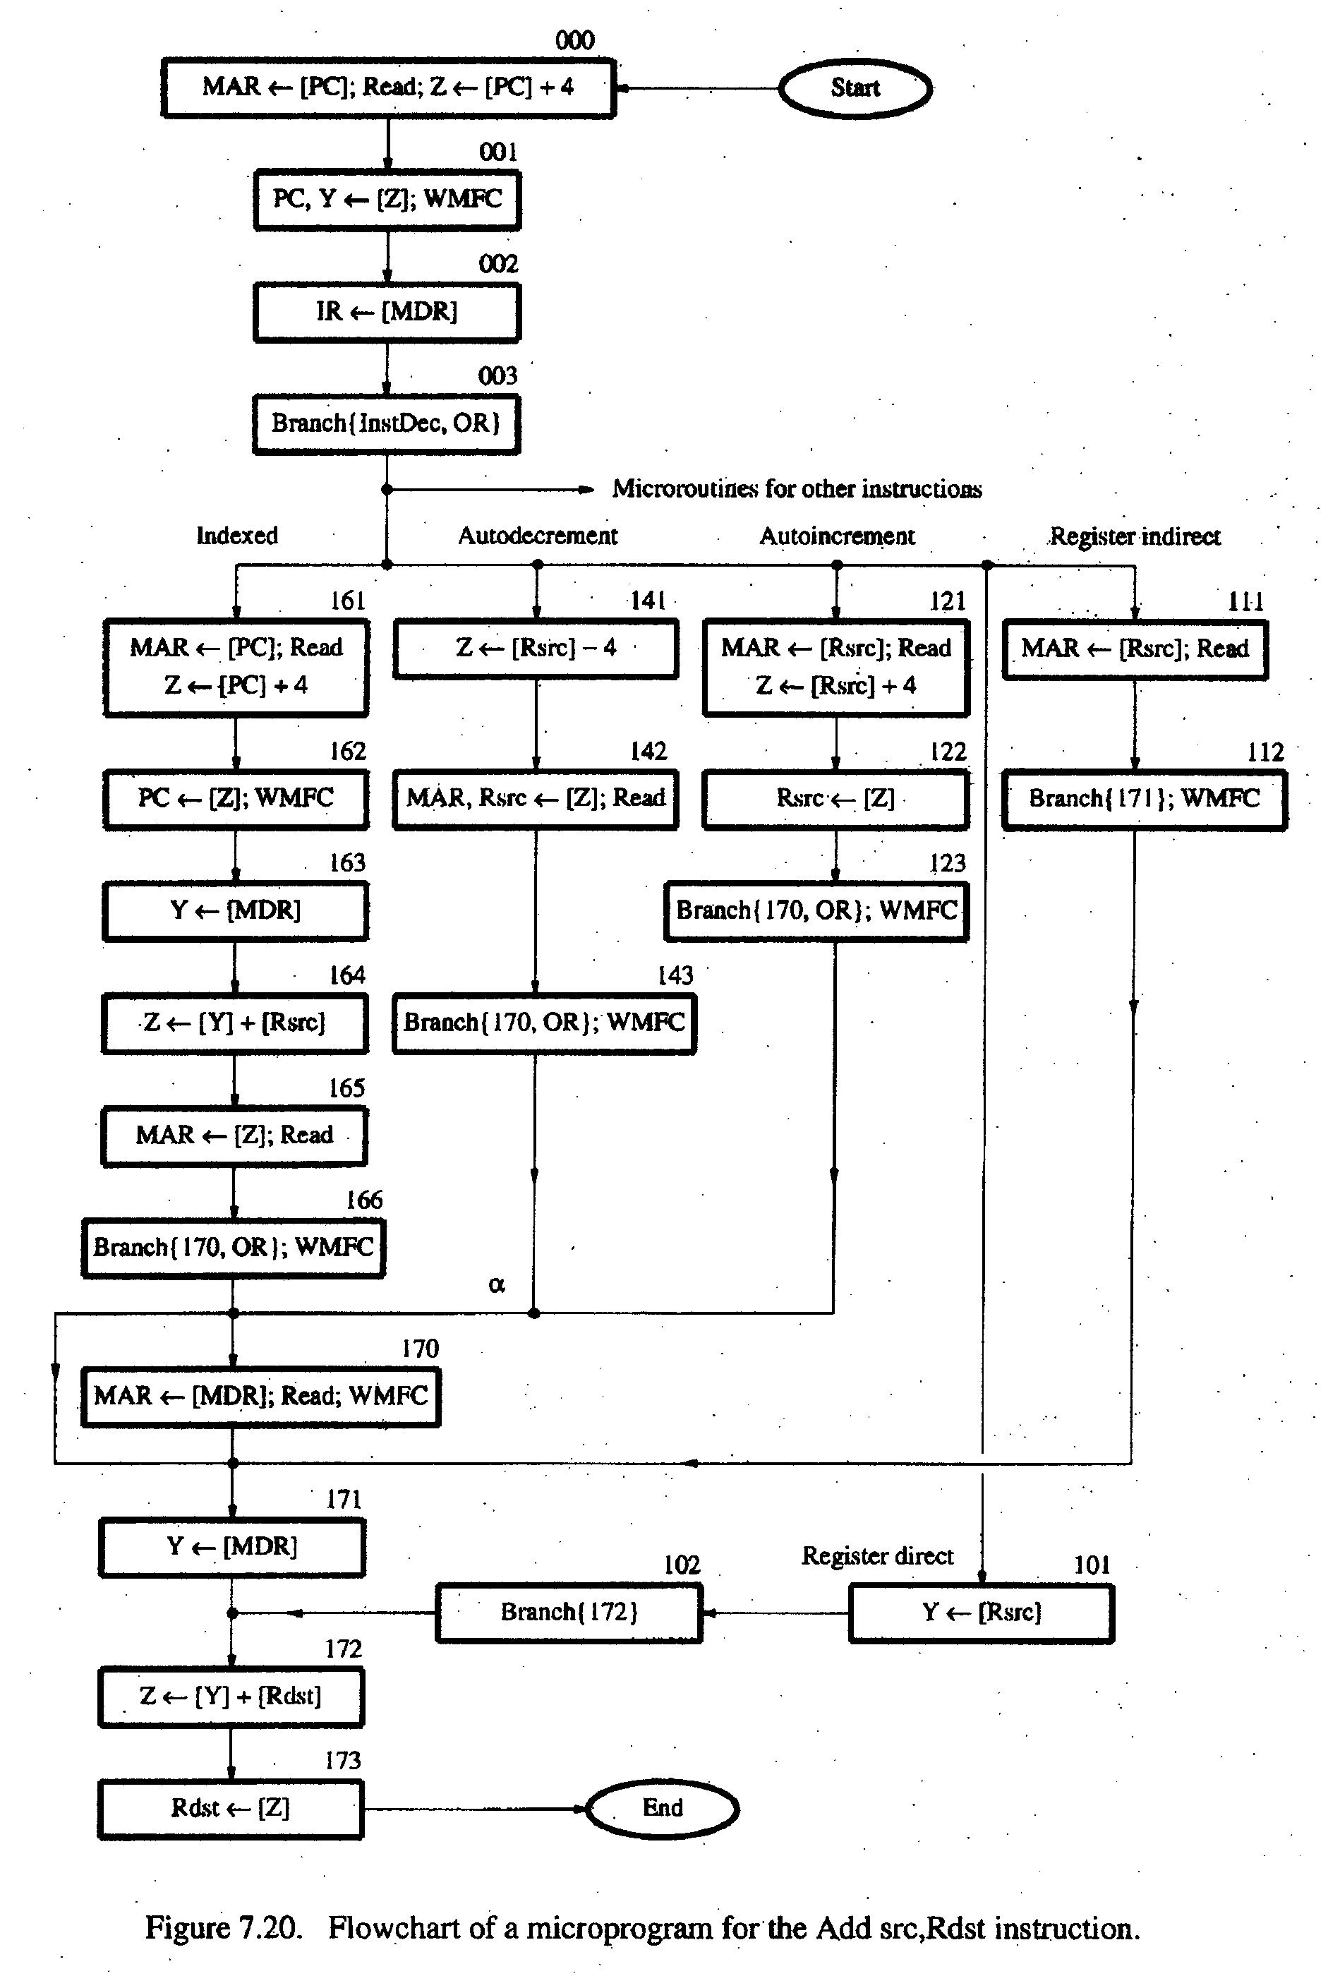
- Bit-ORing
- Wide-Branch Addressing
- WMFC

Slide 36
Branch Address Modification using Bit-ORing
At point labeled ∞, it is necessary to choose between actions required by direct and indirect addressing modes
Indirect mode – 171
Direct mode – 170
Branch micro instruction and specify the address 170 and use an OR gate to change the least significant bit of this address to 1 if the direct addressing mode is involved, known as bit-ORing technique

Slide 37
Thank You

